Slide 1
AVO/GI Seismic Monitoring Software, 2012-2013
Glenn Thompson

Slide 2
Changes
No funding for development
Discontinue & archive all development projects
No funding for maintenance
Make mission critical products easier to maintain
Discontinue & archive others (9)
Alter AVO internal seismology page to reflect changes
New product: The Weekly Report Tool

Slide 3
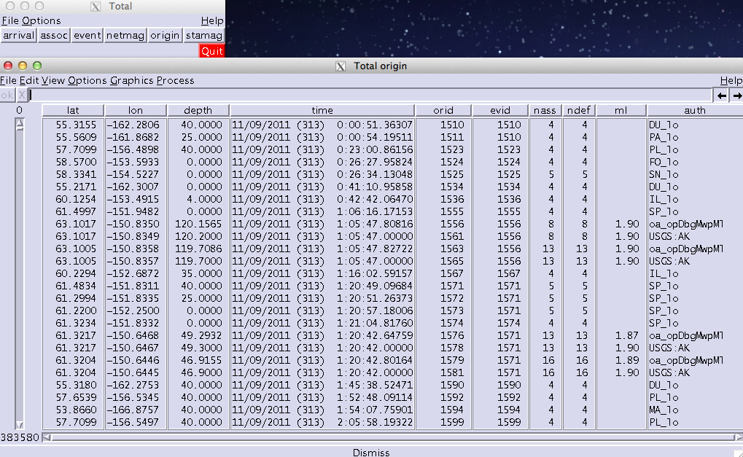
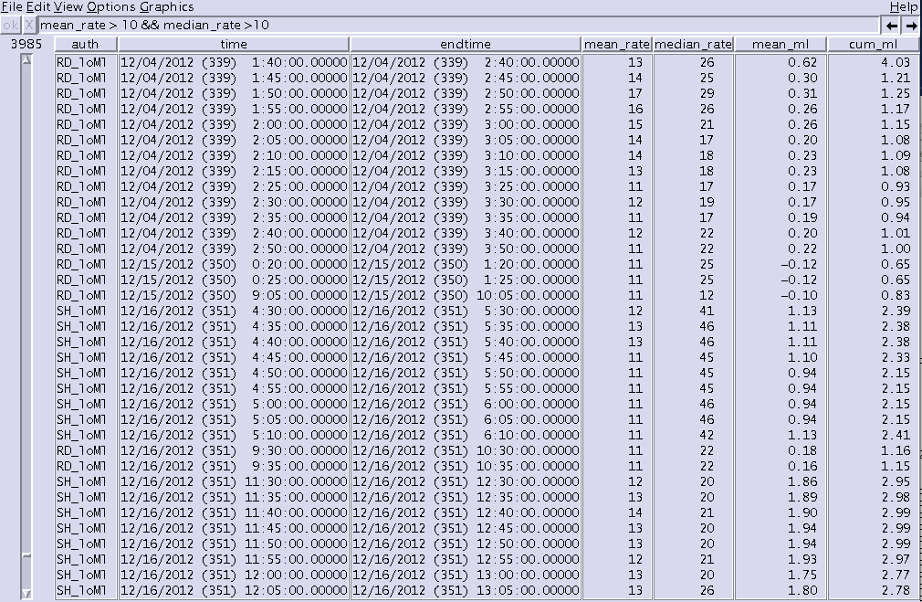
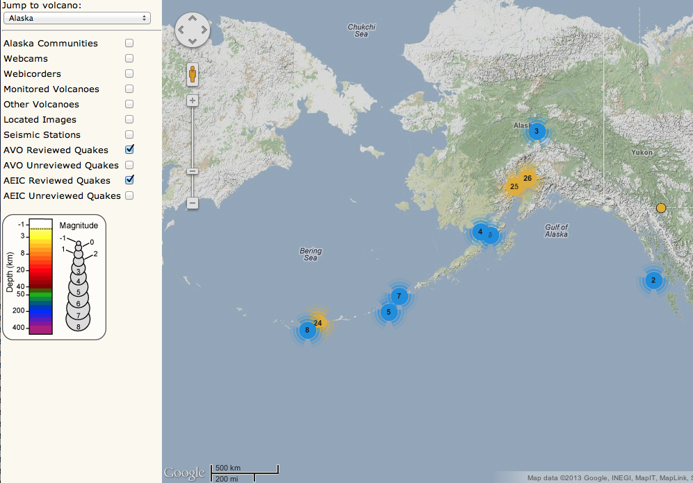
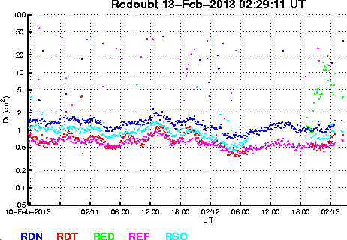
Discontinued (1/3)
Combined real-time catalog
Swarm tracking system/database
Combined epicenter map
Reduced displacement plots

Slide 4
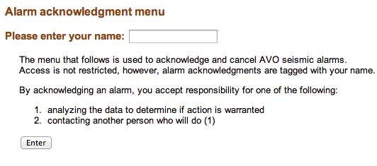
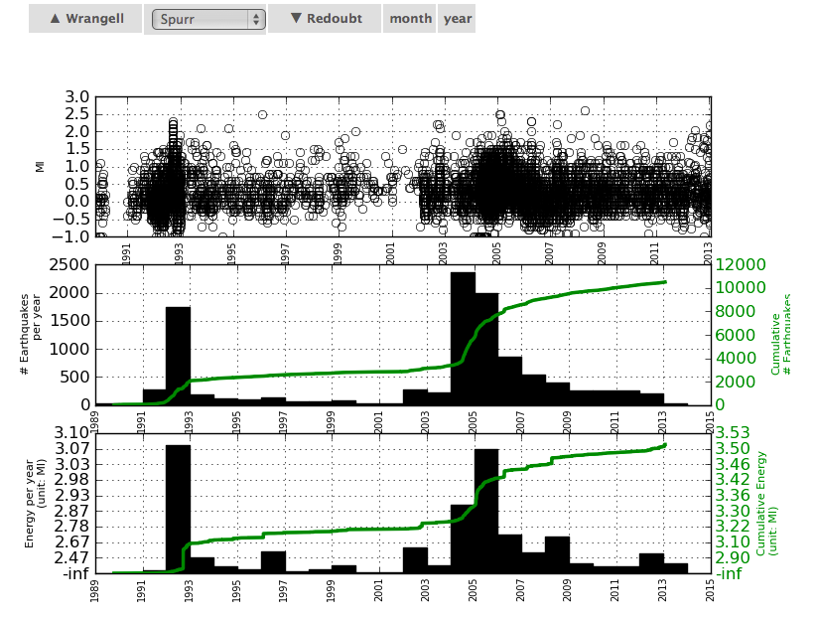
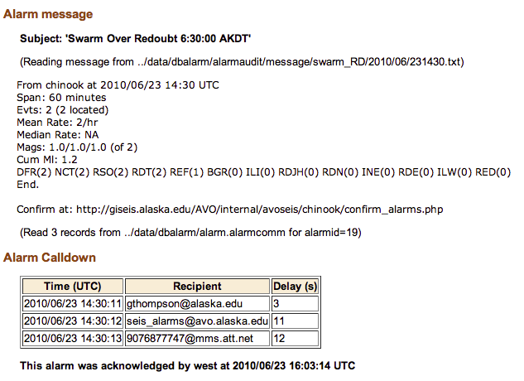
Discontinued (2/3)
Swarm, tremor and diagnostic alarms
Earthquake rate/energy timeseries plots

Slide 5
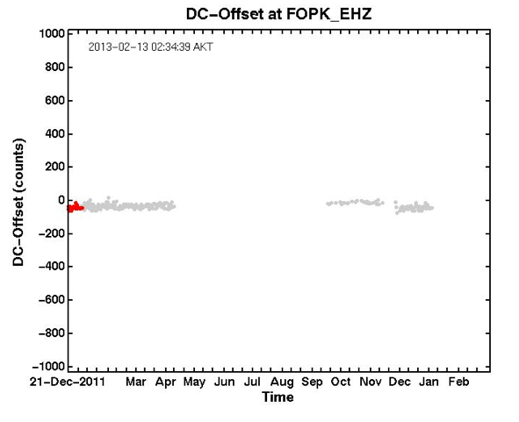
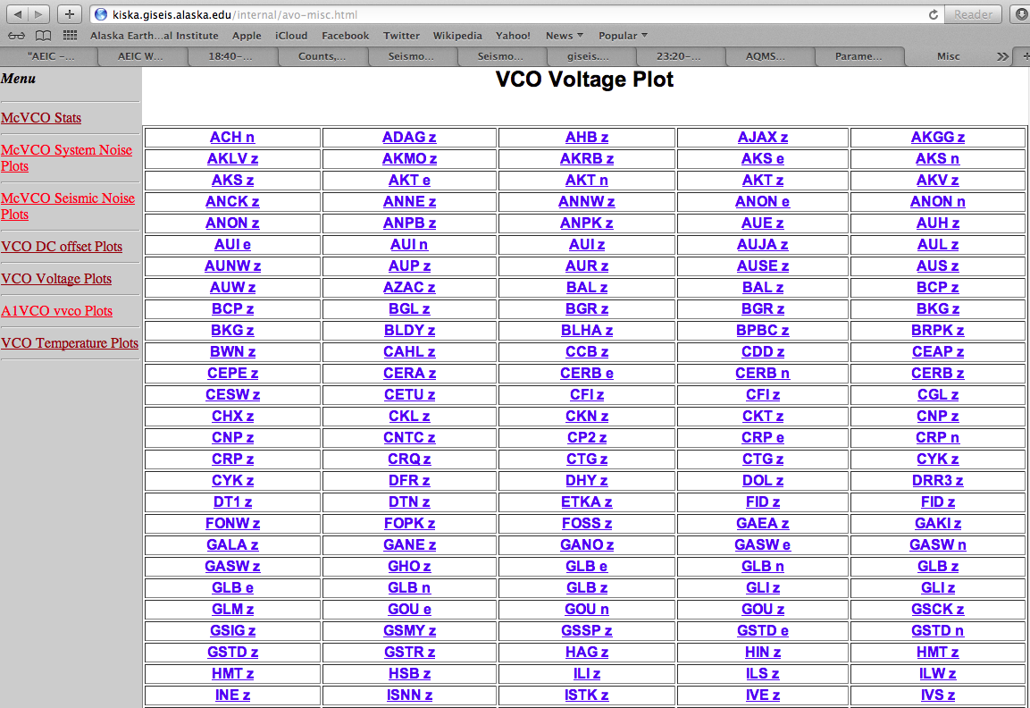
Discontinued (3/3)
VCO diagnostic plots & statistics

Slide 6
Supported products
Public website (4)
Internal (4)

Slide 7
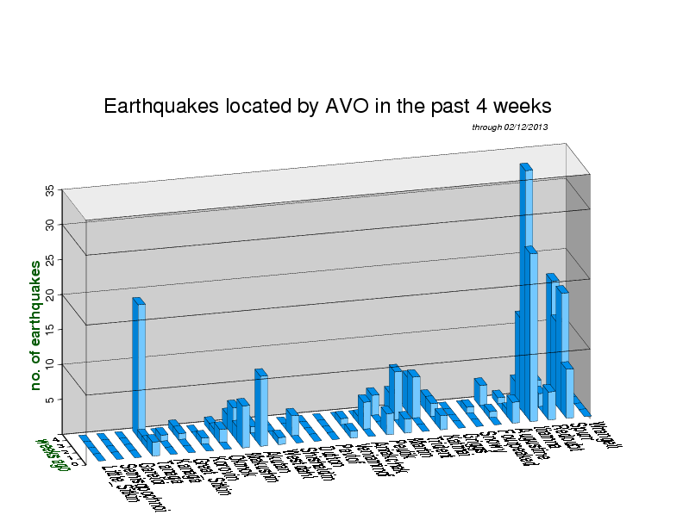
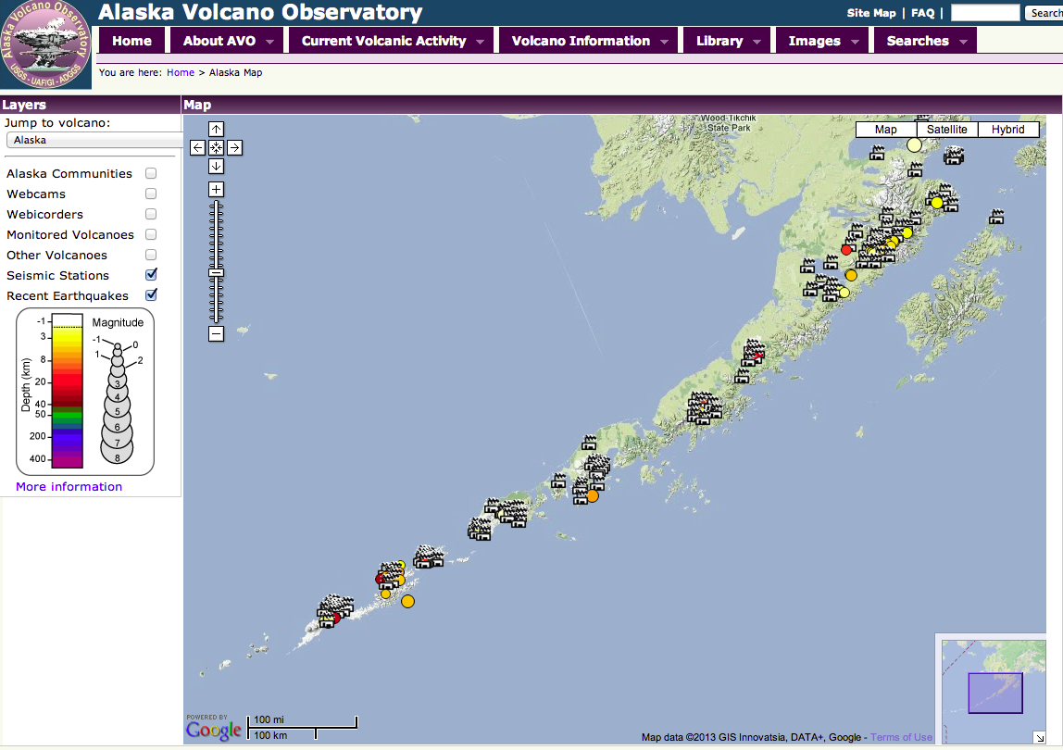
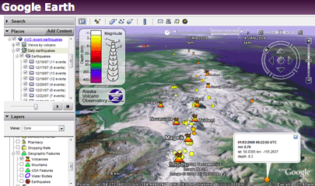
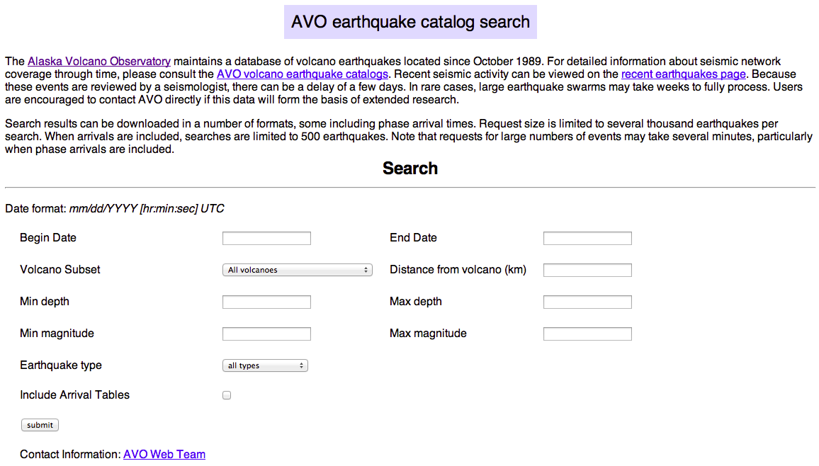
Public web products
XML feeds
Weekly earthquake histogram
KML feeds
AVO catalog search

Slide 8
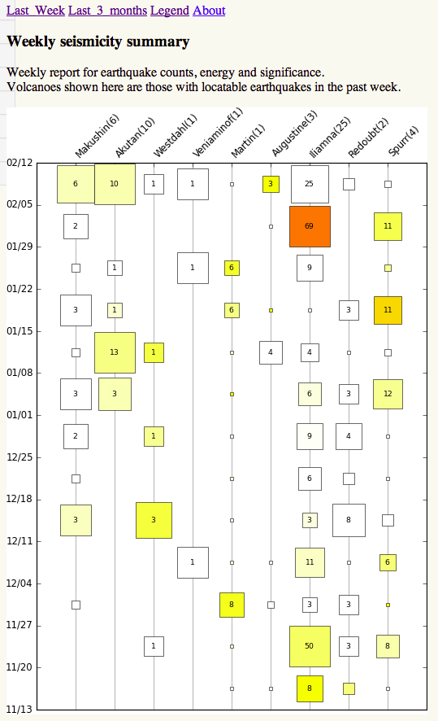
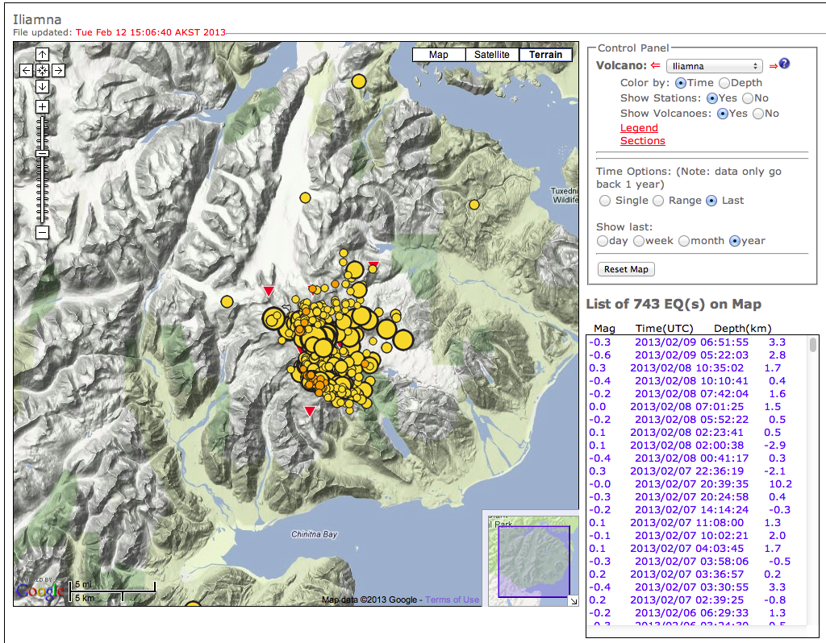
Internal web products (1/2)
Weekly report tool
Epicenter plots (VolcWeb)

Slide 9
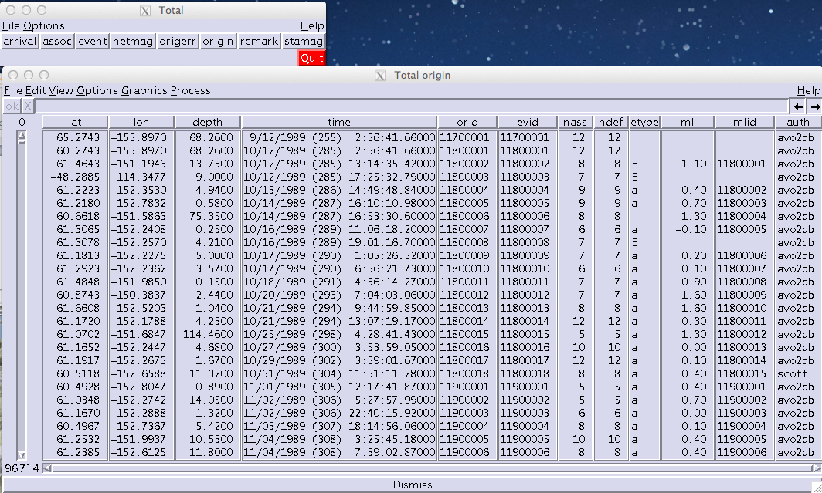
These all depend on…
The AVO catalog (Datascope version)
Begins in 1989
Almost 100,000 located earthquakes
Why Datascope? Why not AQMS (or VALVE)?

Slide 10
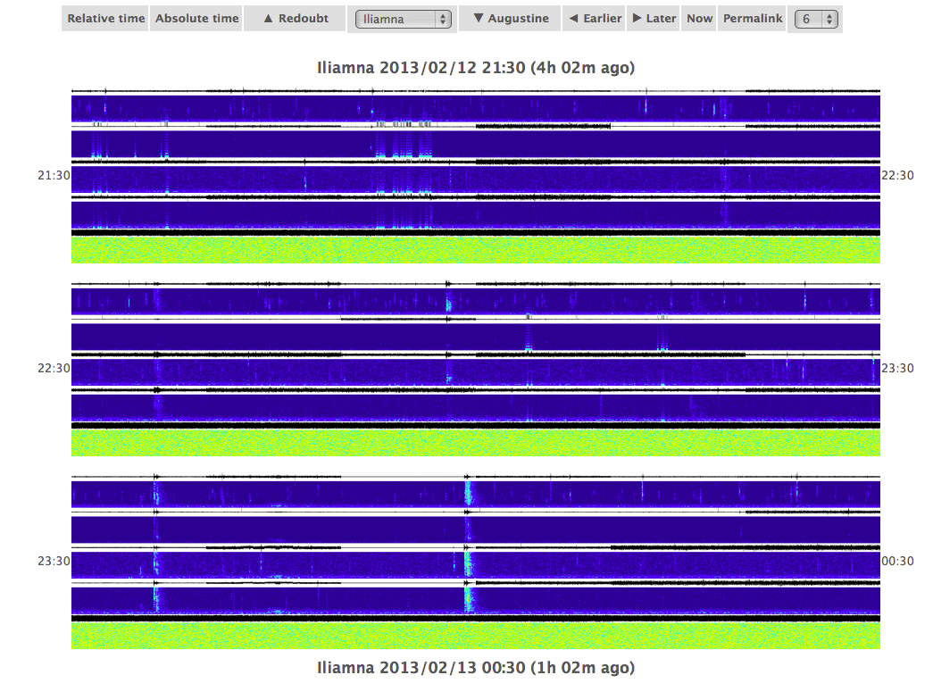
Internal web products (2/2)
Spectrograms
Data layer:
EARTHWORM or WINSTON waveserver, or
Datascope waveform database
Independent of Antelope
PHP Web interface:
Could be used regardless of how spectrograms generated

Slide 11
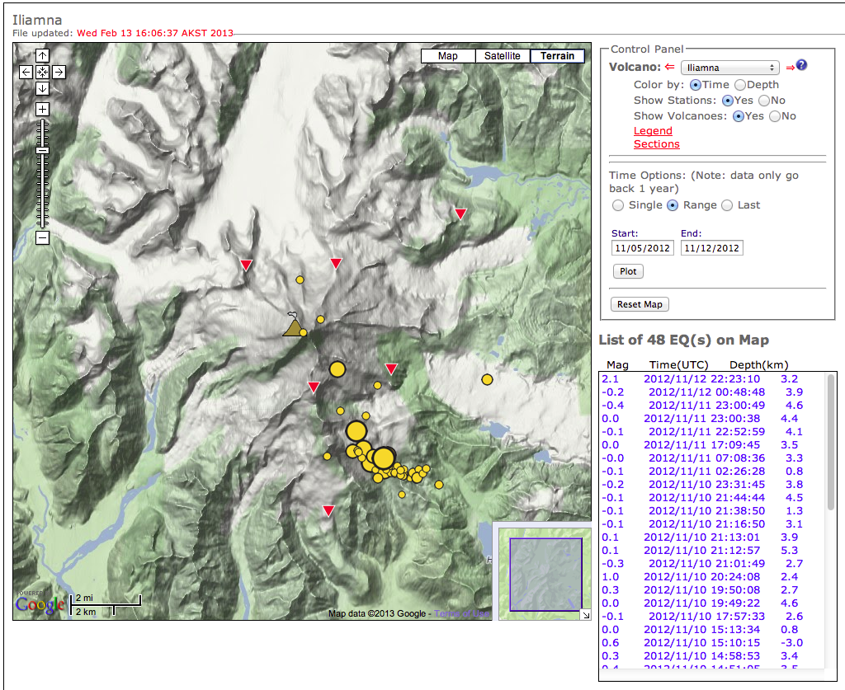
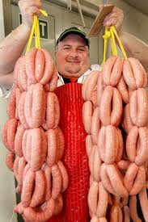
New products
The “Weekly (earthquake) Report Tool”

Slide 12
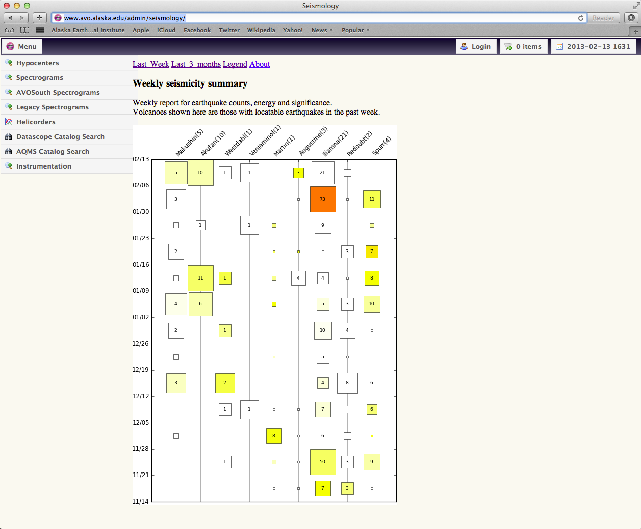
link
Default display when you visit the internal seismology page
NEW PRODUCT
Weekly report tool

Slide 13

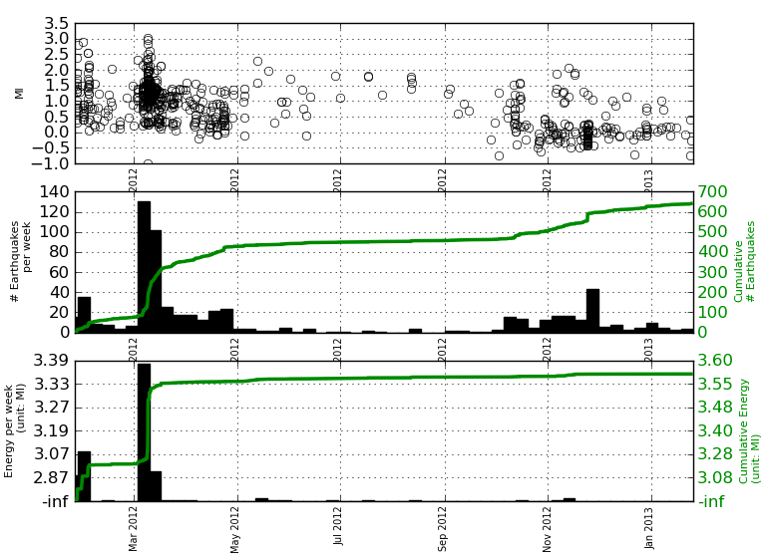
Motivation
Helena Buurman
Tim Bartholomaus
Laura Hutchinson
Matthias Hort
Mike West
Chris Nye
How can we show:
Trends in weekly earthquake counts?
Trends in weekly energy release?
How significant these trends are?
For multiple volcanoes at once?
In a way that can be rapidly digested?
Iliamna, weekly seismicity, past year

Slide 14
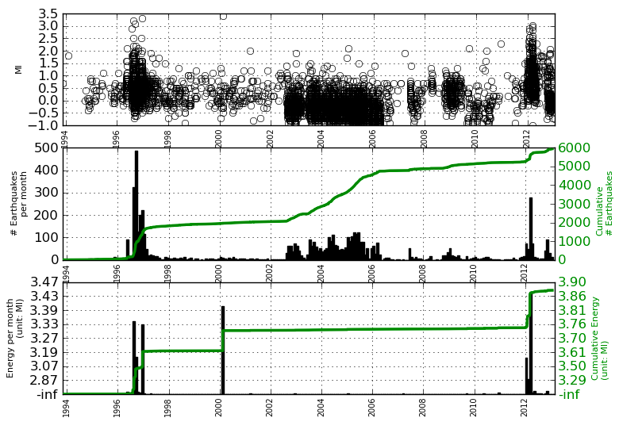
For multiple volcanoes?

Slide 15
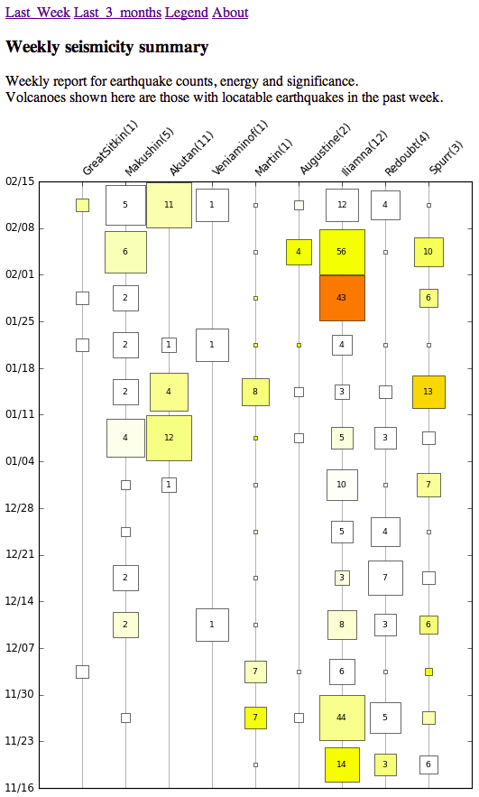
Last week
Volcanoes with earthquakes
in past week (default)

Slide 16
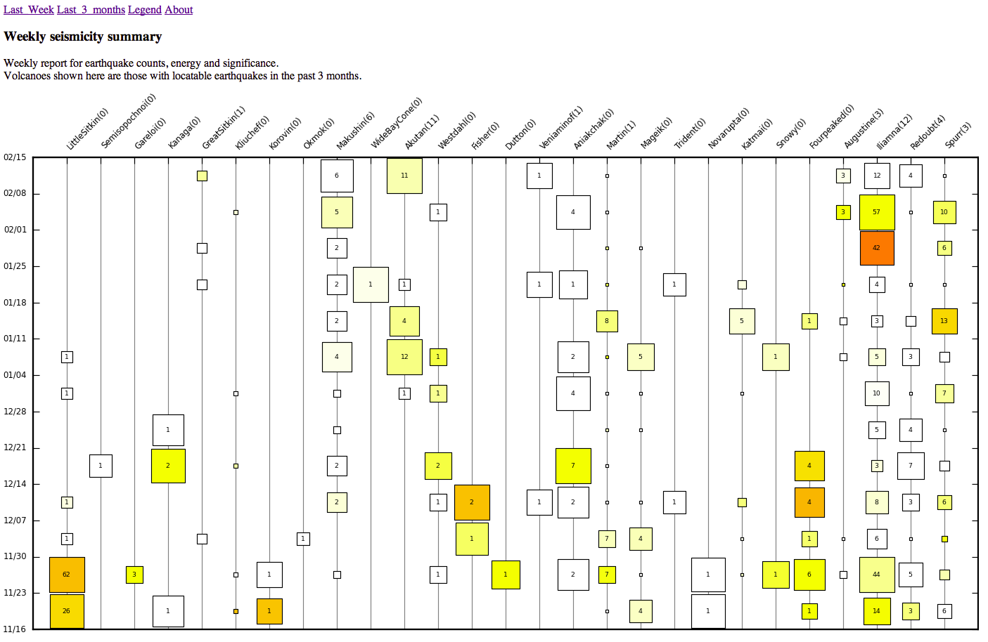
Last 3 months
Volcanoes with earthquakes in past 3 months

Slide 17
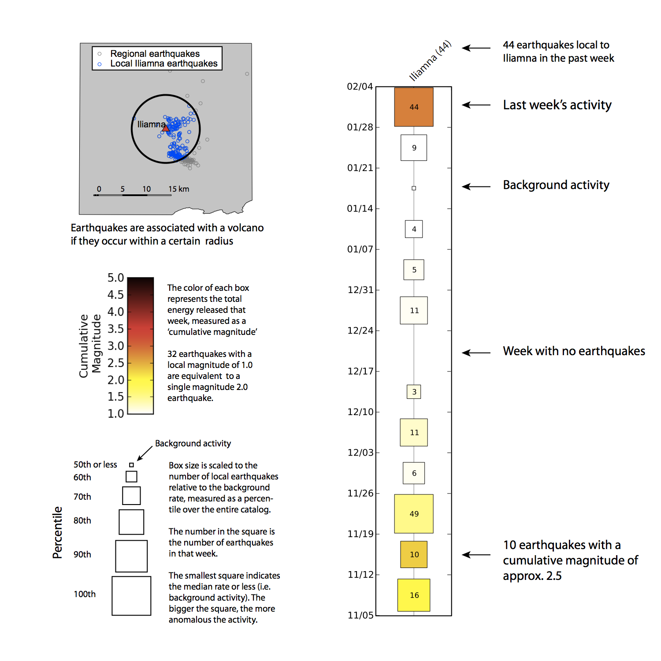
Legend

Slide 18
2-D Array
Volcanoes west-to-east (earthquakes in the past week)
Weeks ago

Slide 19
3-D Array
Each array element has 3 values (counts, energy, significance)
Volcanoes west-to-east (earthquakes in the past week)
Weeks ago

Slide 20
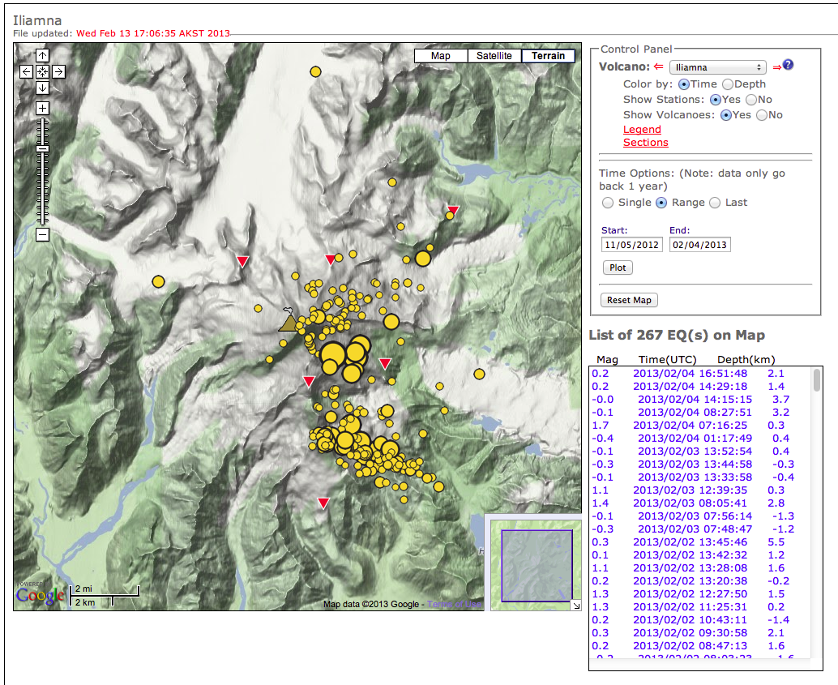
Epicenter maps (VOLC2)

Slide 21
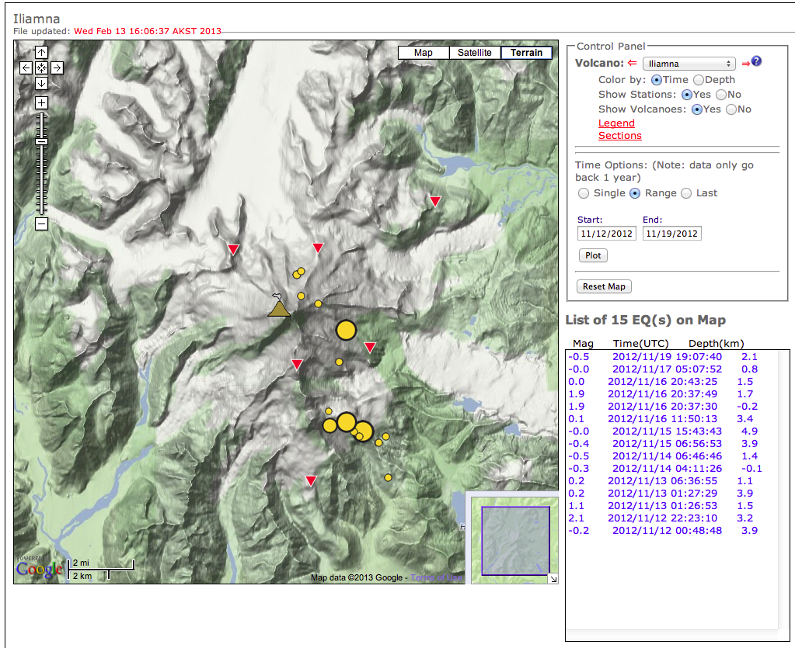
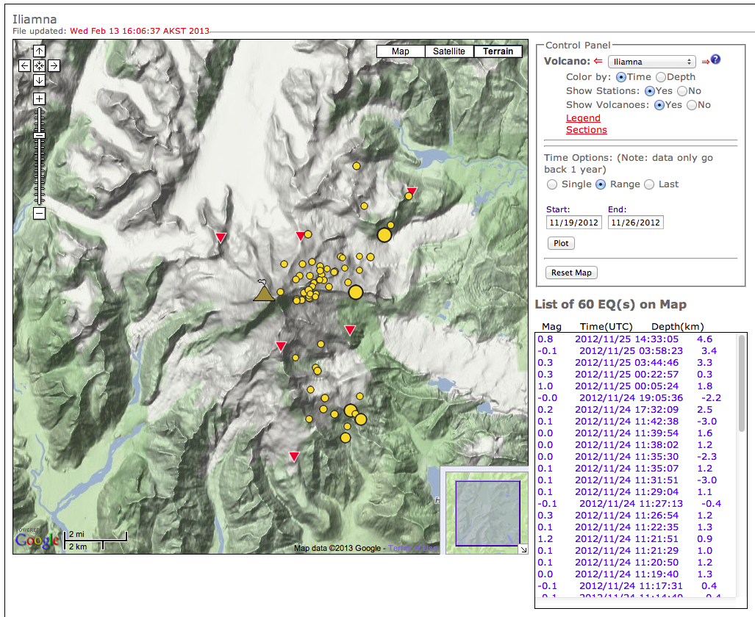
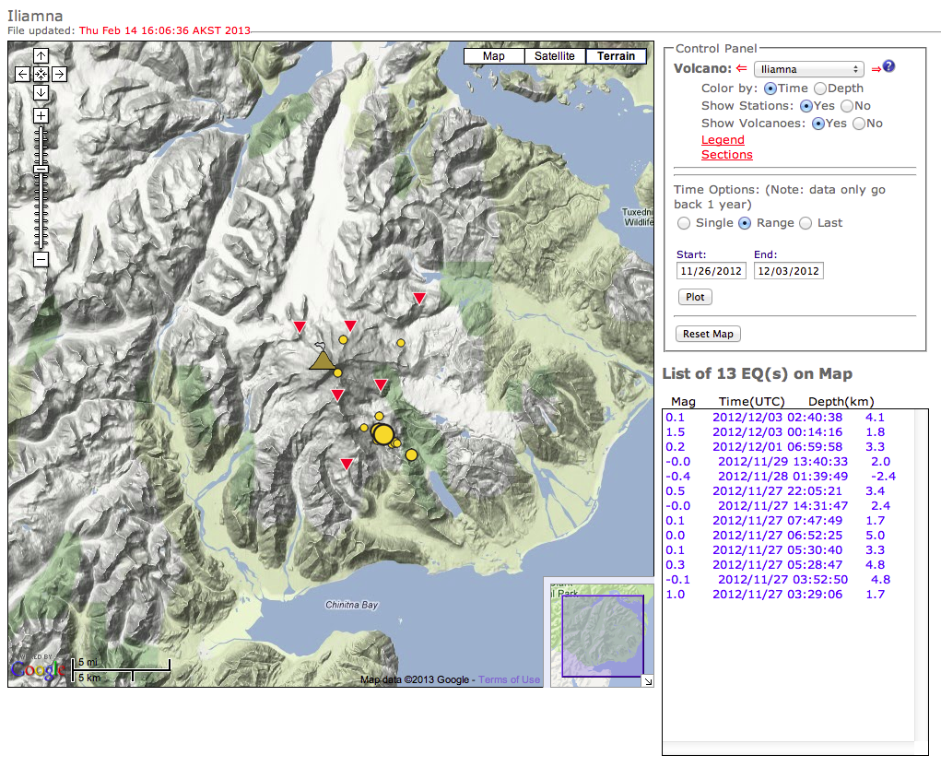
Epicenter maps (VOLC2)
Great for epicenters. But location not that important for an overview.
1 week at a time? For all volcanoes?

Slide 22
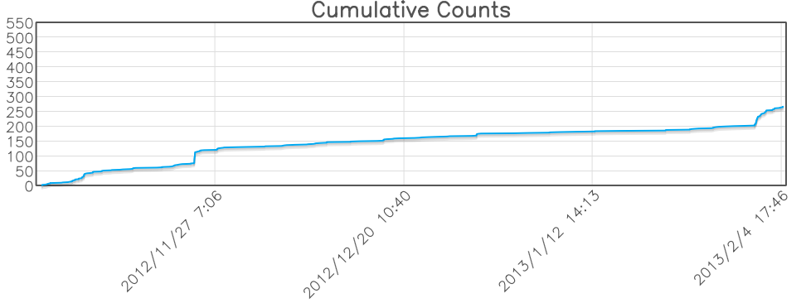
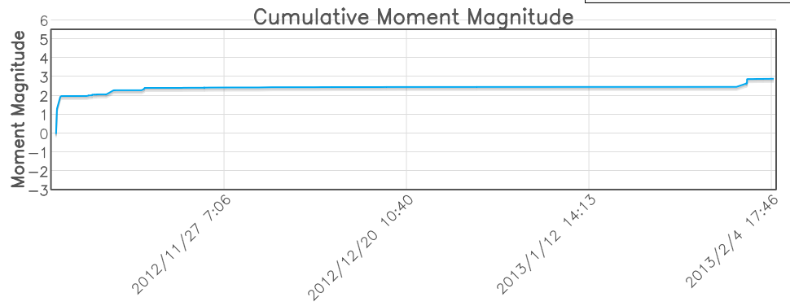
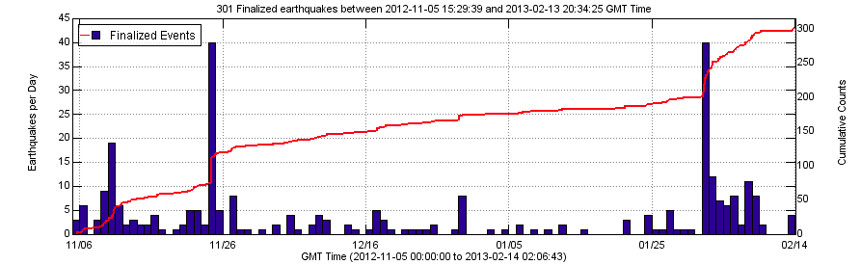
Timeseries plots
“VOLC2” cross-sections
Counts & Energy plots (Python)
VALVE linked through “VOLC2”
Better. 3 different tools that show trends at a single volcano.
But this is still slow. So many volcanoes!

Slide 23
Best tool for looking at long term trends

Slide 24
Weekly volcanic earthquake activity: What trends matter?
Are we recording MORE earthquakes?
Are the squares getting BIGGER?
Are we recording BIGGER earthquakes?
Is the total energy release rate increasing?
Are the squares getting REDDER?
How SIGNIFICANT is X earthquakes in a week at volcano Y?
How BIG are the squares?

Slide 25
44 earthquakes in last week at Iliamna
Numbers in the squares = Counts
44
9
1
4
5
11
0
3
11
6
49
10
16

Slide 26
Size = Significance
Size indicates significance of that number of earthquakes in 1 week at that particular volcano.
5 earthquakes at Makushin is significant. 5 at Katmai is not.
Significance based on PERCENTILE.
95th
80th
<=50th
67th
72nd
85th
(0)
62nd
85th
75th
99th
82nd
90th

Slide 27
44 earthquakes in last week at Iliamna
Numbers in the squares = Counts
44
9
1
4
5
11
0
3
11
6
49
10
16
1200 samples of “earthquakes per week” in chronological order:
[1, 0, 0, 0, 5, 0, 18, ...(1180 other samples) …, 16, 10, 49, 5, 11, 3, 0, 11, 5, 4, 1, 9, 44]
Arrange them in numerical order:
[0, 0, 0, 0, …, 43, 44, 47, 49, 61, 87, 112]

Slide 28
Color = Energy release
Color indicates the cumulative magnitude of all earthquakes in 1 week at that particular volcano.
Cumulative magnitude is a convenient representation of total energy release.
2.9
<=1.0
<=1.0
<=1.0
1.1
1.1
(-Inf)
1.2
1.3
1.1
1.5
2.5
1.8

Slide 29
Which earthquakes are included?

Slide 30
The AVO Catalog
(Datascope)
Begins in 1989
(~ 1200
Weeks)
Almost 100,000 located earthquakes

Slide 31
Size = Significance
Size indicates significance of that number of earthquakes in 1 week at that particular volcano.
5 earthquakes at Makushin is significant. 5 at Katmai is not.
Significance based on PERCENTILE.
95th
80th
<=50th
67th
72nd
85th
(0)
62nd
85th
75th
99th
82nd
90th
Catalog ~ 1200 weeks
First week = first earthquake recorded at that volcano
Up to 1200 “samples” of “earthquakes per week”
Background activity = median (50th %ile) or less

Slide 32
For each volcano, a radius is defined.
Only earthquakes within this radius are counted.

Slide 33
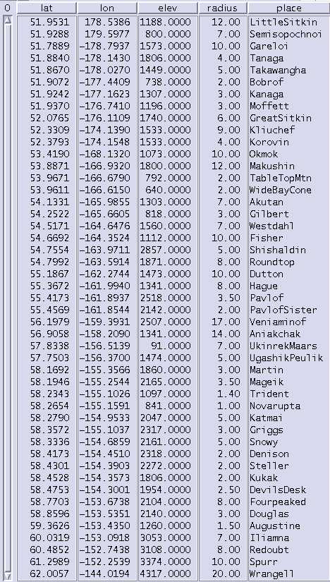
For Iliamna the radius is 7 km.
There are 47 volcanoes in the list.
The list is from Helena’s research.

Slide 34
In 90% of weeks in the AVO catalog, there are fewer than 16 events at Iliamna
6 earthquakes from 11/26 to 12/03.,
75th percentile.
Cumulative magnitude 1.1
49 earthquakes from 11/19 to 11/26.
97th percentile.
Cumulative magnitude 1.5
16 earthquakes from 11/05 to 11/12.
90th percentile.
Cumulative magnitude 1.8

Slide 35
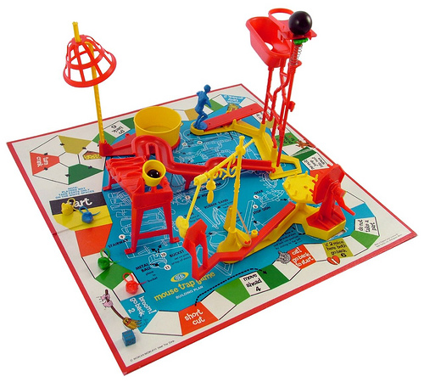

Software design
Building with flat files
Building with databases
Convoluted
Unnecessary points of failure
Expensive to develop and maintain
Simple
Easy to develop & maintain = cheap

Slide 36
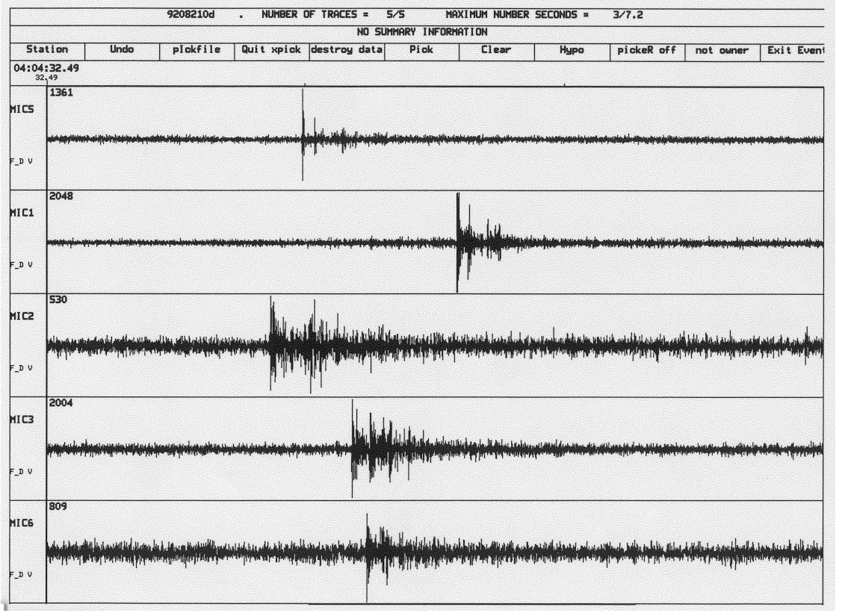
Earthquake catalog - before
Data from field
Earthworm
SAC files
Datascope
Research
AVO/GI Web Apps
Hypocenter Maps
VALVE

Slide 37
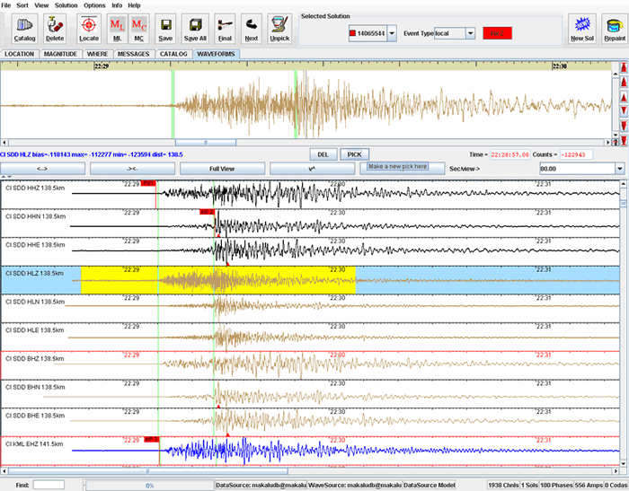
Earthquake catalog - planned
Data from field
Earthworm
AQMS
Datascope
VALVE
Synchronization at database level
Apps moved upstream
Research
AVO/GI Web Apps

Slide 38
Earthquake catalog - today
Data from field
Earthworm
AQMS
Datascope
VALVE
Research
AVO/GI Web Apps
Hypocenter Maps

Slide 39
AVOSEIS/GI products
Casualties of a shrinking budget
Spectrograms*
Hypocenter plots*
Weekly report tool
AVO map feeds (recent earthquakes, seismic stations) http://www.avo.alaska.edu/map/
Datascope version of AVO catalog for researchers
Earthquake summary plot00
Earthquake count/energy plots
Real-time catalog**
Swarm alarm system*
Helicorder plots
Tremor alarm system*
State-of-health plots*
Reduced displacement plots

Slide 40
Summary
Maintained:
Spectrograms
Hypocenter plots
Weekly report tool
AVO map feeds (recent earthquakes, seismic stations) http://www.avo.alaska.edu/map/
Datascope version of AVO catalog for researchers
Earthquake summary plot
Retired:
Earthquake count/energy plots
Real-time catalog
Swarm alarm system
Helicorder plots
Tremor alarm system
State-of-health plots
Reduced displacement plots
Diagnostic alarm system

